Slide 1
Road to a Faster Web
https://geek.hellyer.kiwi/ htttps://twitter.com/ryanhellyer/

Slide 3
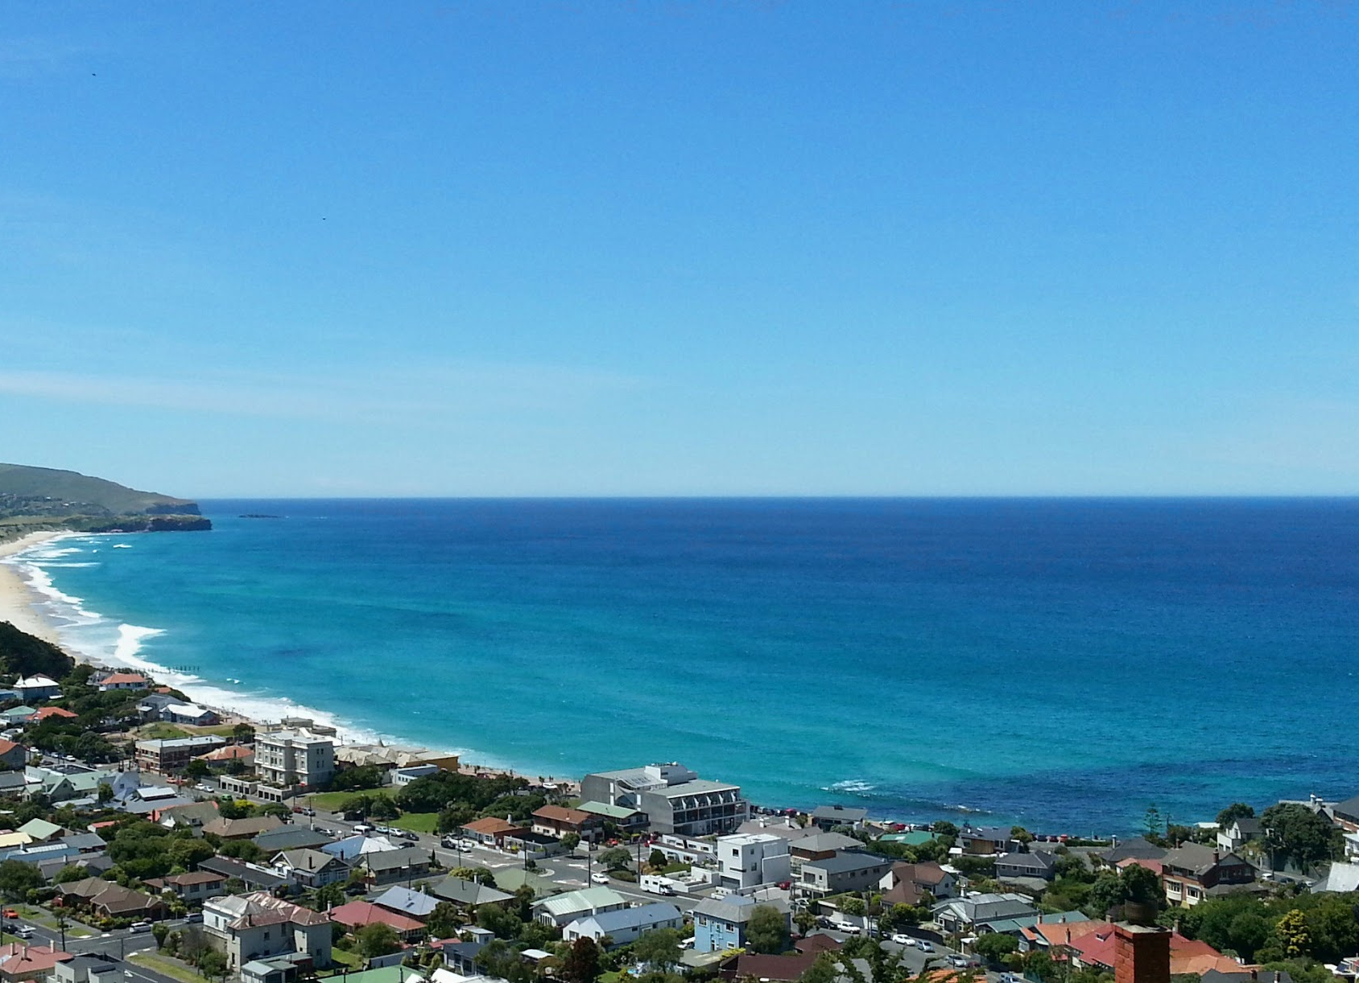
Land of the worlds worst internet

Slide 4
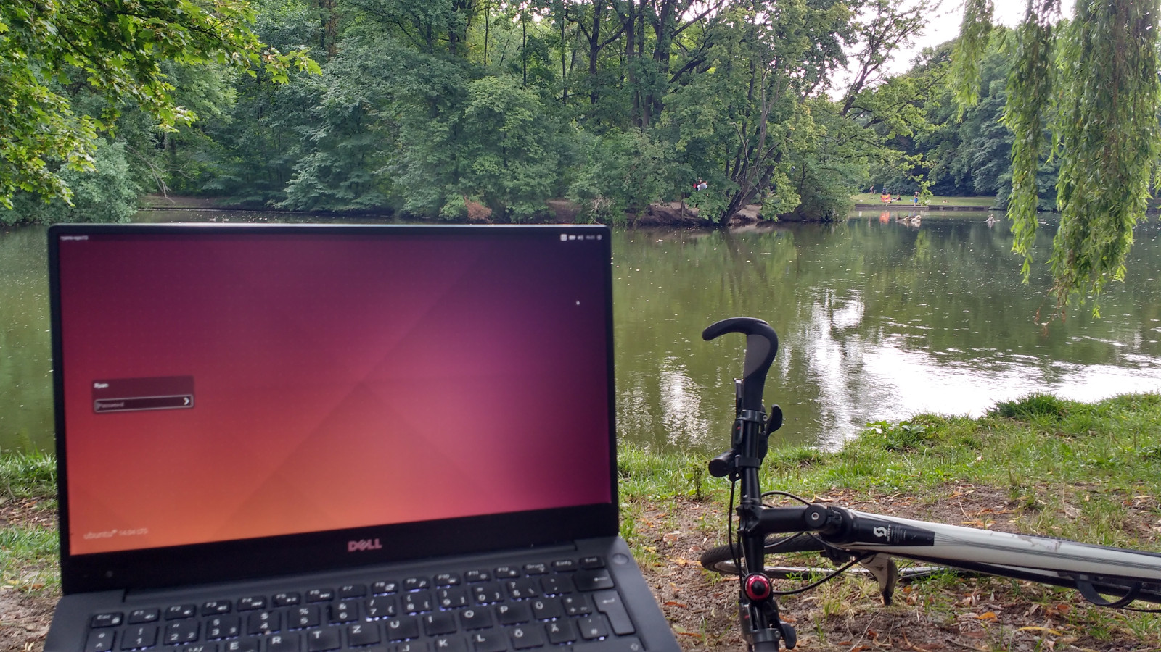

Slide 5
Local ice hockey club - 2006
2006 - .html site
2007 - WordPress

Slide 6
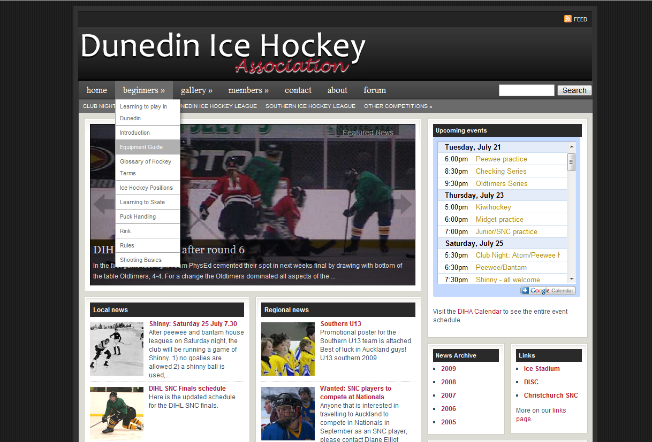

Slide 7
Dropdown menus in WordPress
Miriam Schwab of wpgarage.com
Choices
Apologise
Take it down
Make my own
https://geek.hellyer.kiwi/ htttps://twitter.com/ryanhellyer/

Slide 8
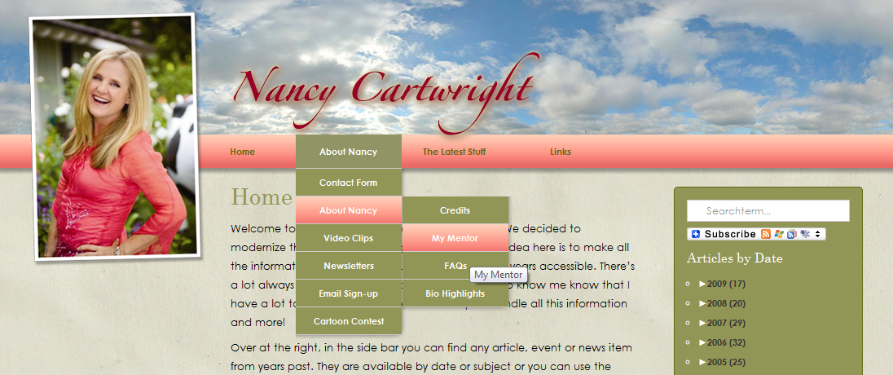
Menu plugin users …
John McCain
Nancy Cartwright (Bart Simpson)
9

Slide 9
Scaling up client sites
Scenario
No traffic yet as not promoted
Users register, create profile page, then add their own “dream”
Potentially 100,000+ regularly updated pages, so not static page caching

Slide 11
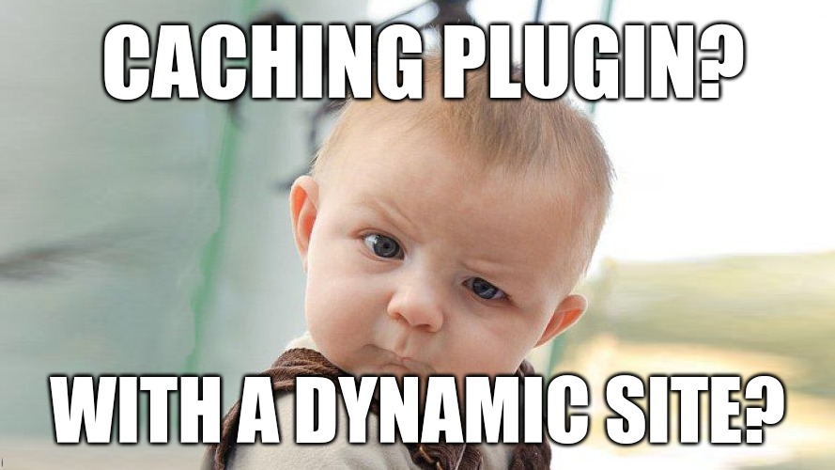

Slide 13
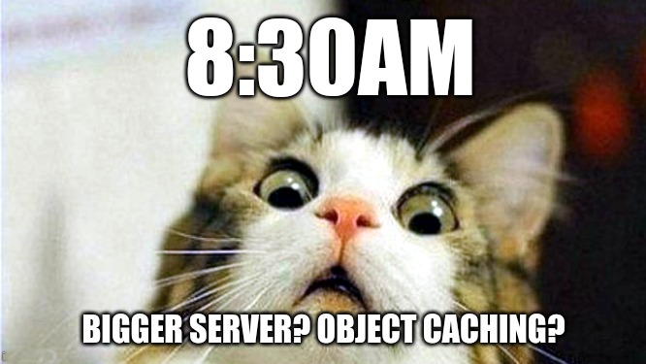

Slide 14
JavaScript
Force log out users
Stored cookie with username and preferred dream.
Used to display name and preferred dream even when logged out.

Slide 15
Query count … ~80 -> ~0

Slide 18
21

Slide 20
Static .html files
Cheap
Easy
Fast
Secure

Slide 22
Hannah Smith
“Serverless needs a better name” - me

Slide 23
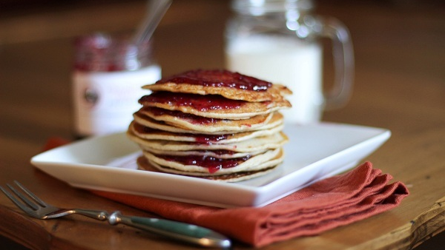

Slide 25
How to JAMstack WordPress?
Irish invention WP Super Cache
WP2Static plugin

Slide 26
JAMstack WordPress hosts
Generate static files

Slide 27
Now working for Miriam
https://www.strattic.com/

Slide 28
URL hunting
Multilingual URLs
Polylang
WPML
Beaver Builder
Generates dynamic static files
Future: query vars, AJAX POST
https://www.strattic.com/

Slide 29
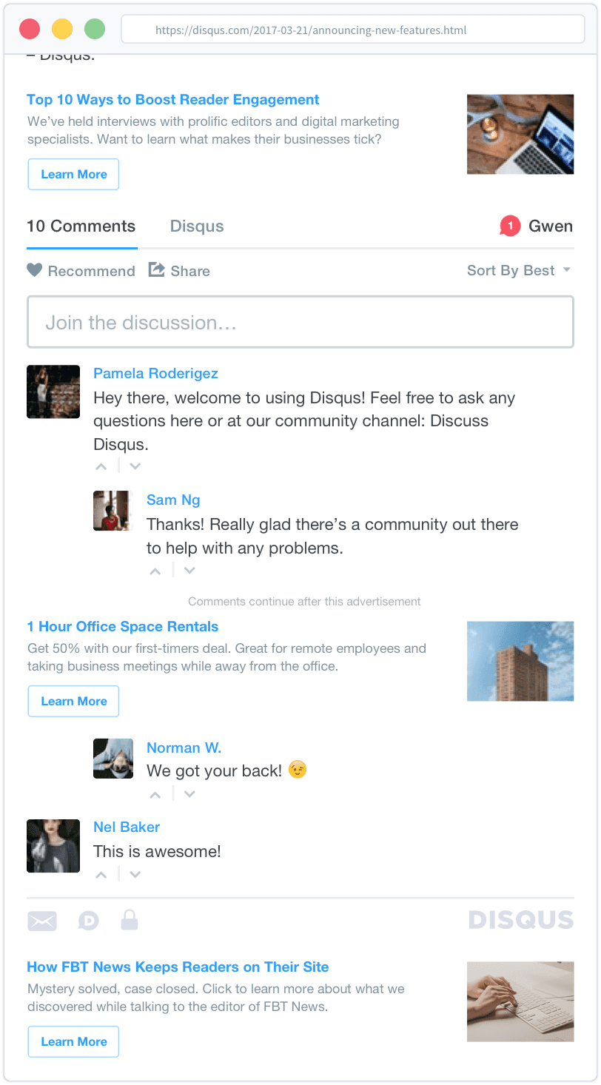
Comments
Custom Lambda based systems also possible

Slide 30
Search

Slide 32
Helpful list of tools
https://www.strattic.com/static-tools/
35

Slide 34
https://www.strattic.com/ Shameless promo slide ^

Slide 36
Potential solutions
Microcaching

Slide 37
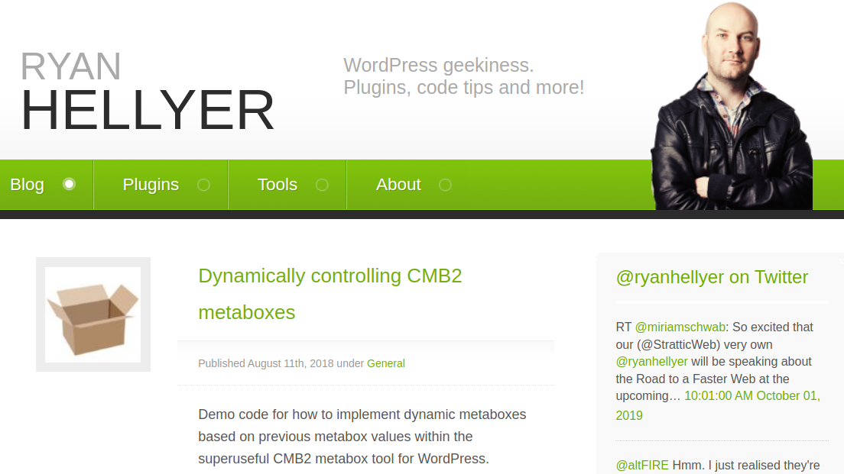

Slide 38
Caching your bits
Widgets https://github.com/kasparsd/widget-output-cache
Fragment caching plugin https://github.com/Rarst/fragment-cache
Menus https://geek.hellyer.kiwi/plugins/menu-cache/

Slide 39
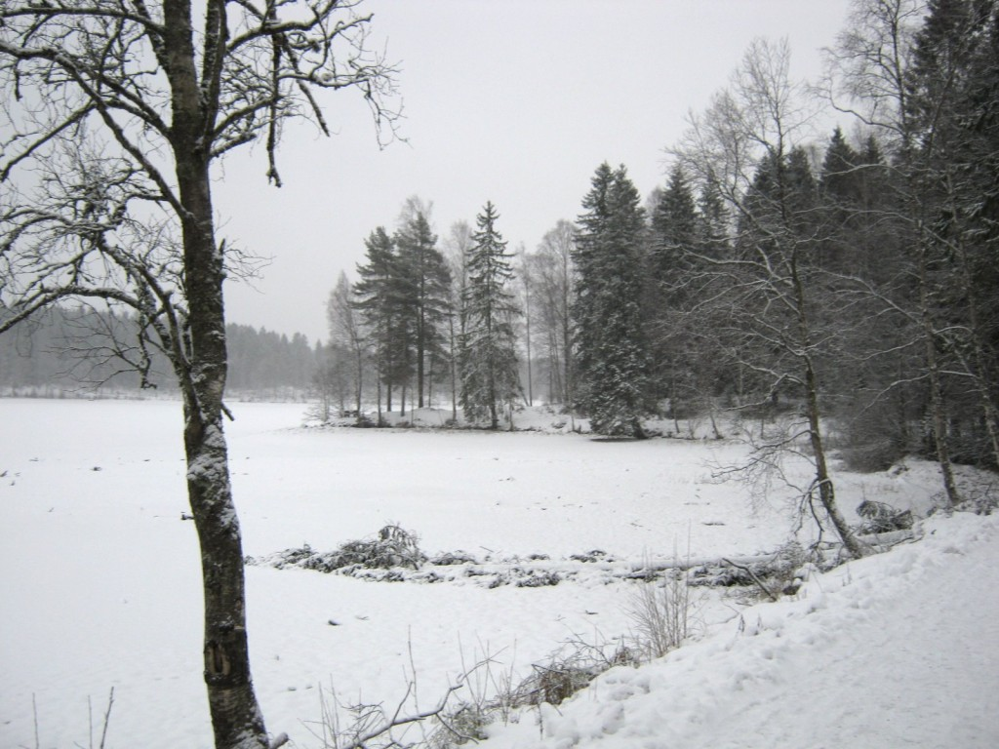
Norway

Slide 41
“Serverless”
AWS Lambda’s
AWS Aurora “Serverless”
AWS S3
AWS CloudFront

Slide 42
Other APIs
Login/registration Facebook Connect
Auth0
Ecommerce
Snipcart
Events
loxi.io

Slide 43
Berlin

Slide 44
Automatic support
Search
Double slashes
Easy form handling
(with limitations)
https://www.strattic.com/

Slide 45
On page performance
HTML minification
CSS/JS minification
Image/video compression
Reducing http requests
https://www.strattic.com/

Slide 46
Future URLs
Query vars
AJAX POST requests
and more ...
https://www.strattic.com/

Slide 48
“Traditional” JAMstack sites

